Slide 1



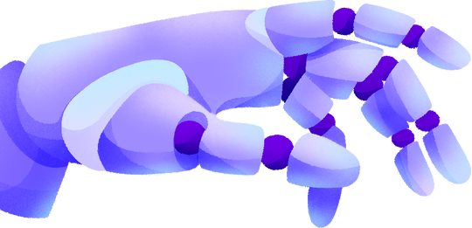

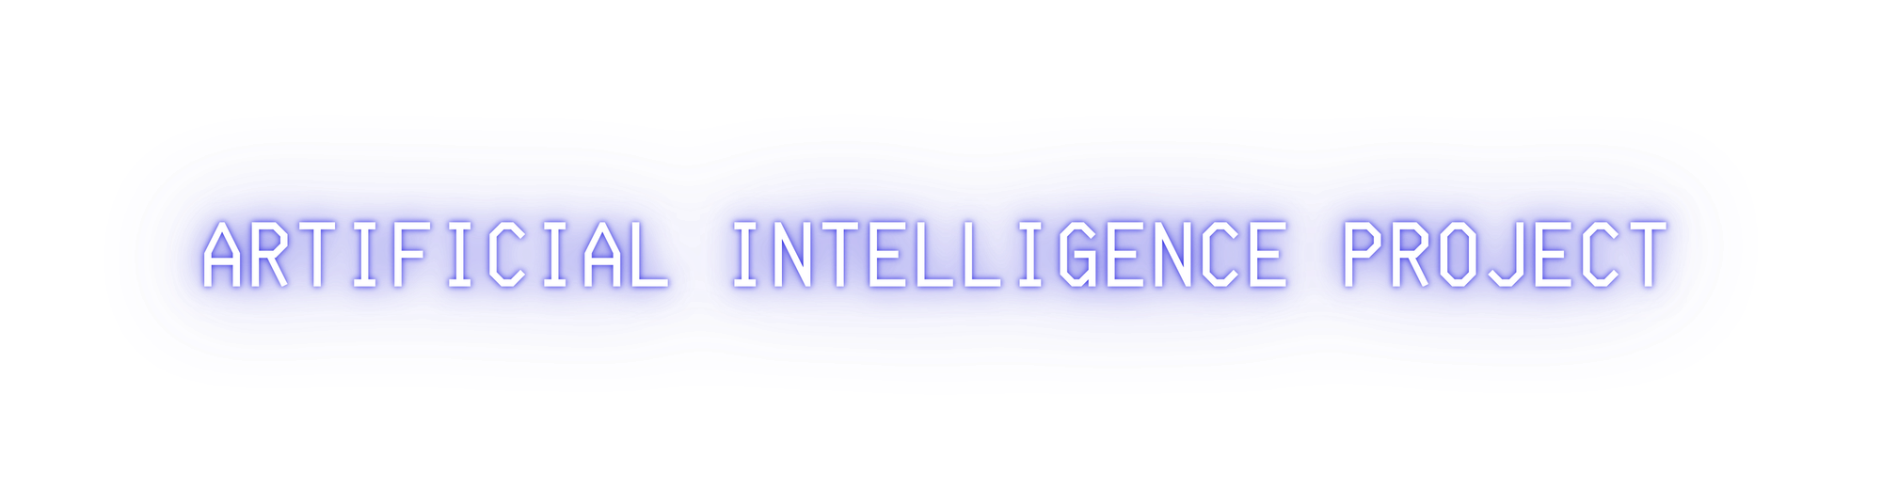



NEXT WORD PREDICTION MODEL
TEAM MEMBERS :
SHRIYA (RA2111026010345)
MOHITH VINAYAK KODALI (RA2111026010358)

Slide 2

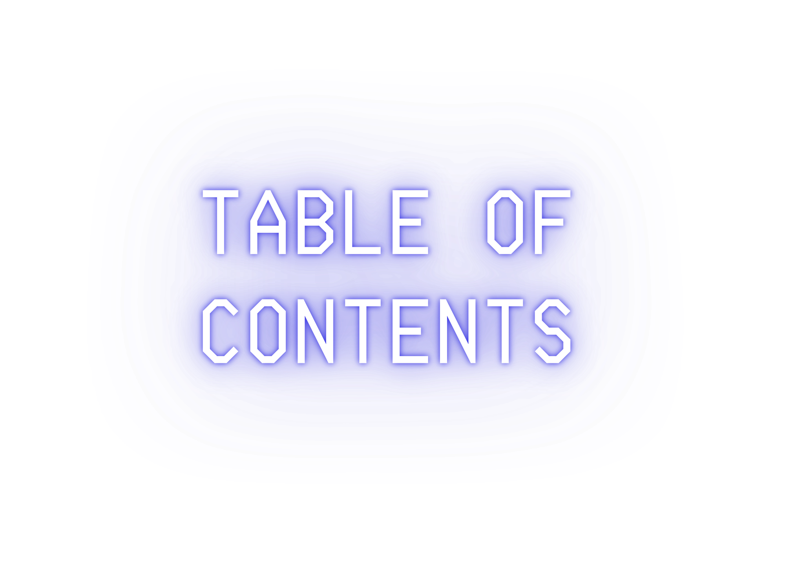
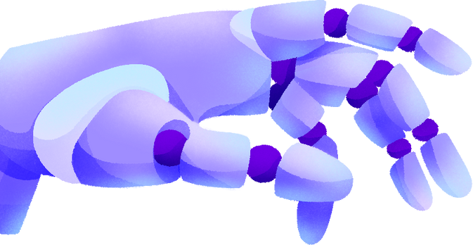

Introduction Project Objectives
Technical Architecture Methodology Technology And Libraries
Callbacks For Training Model Implementation
Result Conclusion

Slide 3

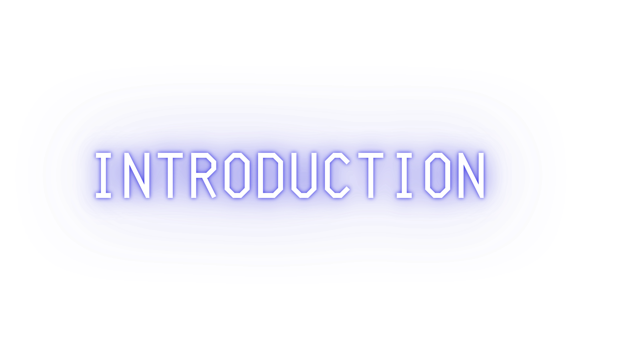

Next-word prediction is a crucial aspect of natural language processing (NLP), empowering machines to anticipate a user's next word based on their previous input. This functionality finds wide application in tasks like text completion and speech recognition. Traditionally, statistical models like n- grams and Markov models were used, but deep learning techniques, particularly recurrent neural networks (RNNs) and transformers, have revolutionized next-word prediction. These models offer better accuracy and efficiency, yet challenges persist, including data scarcity, syntactical complexity, and computational demands, driving ongoing research for more effective solutions.

Slide 4


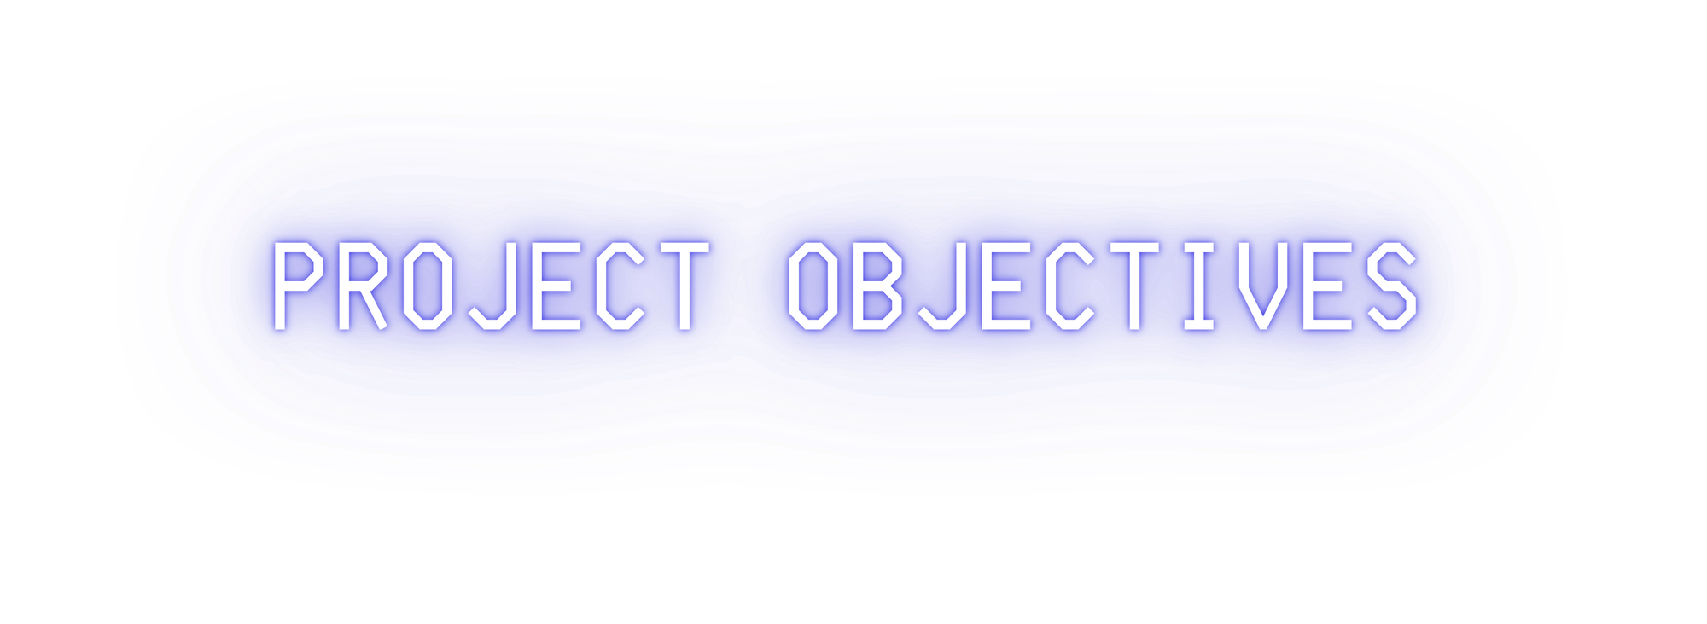







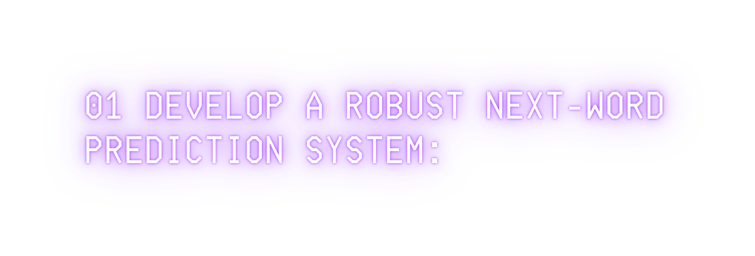
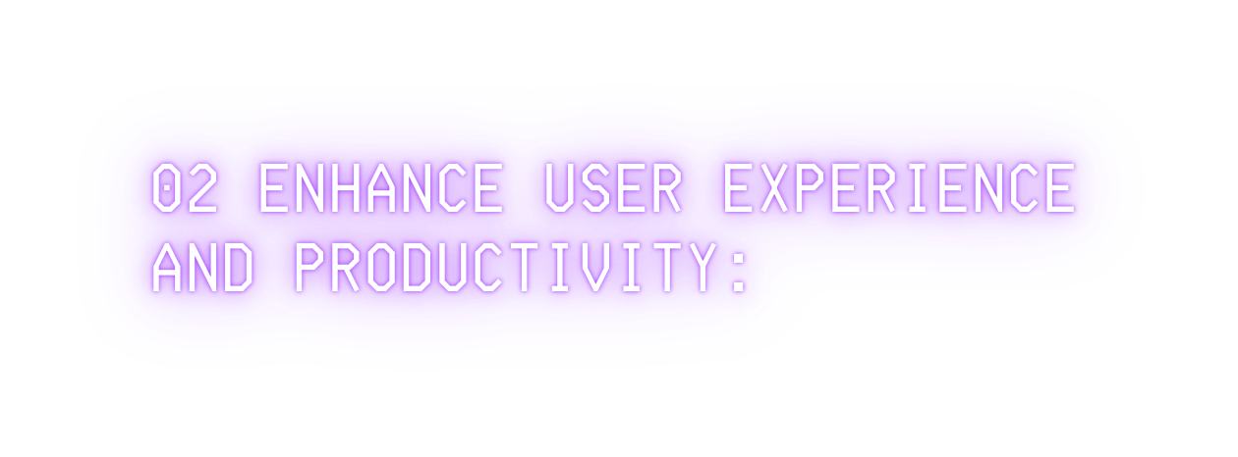
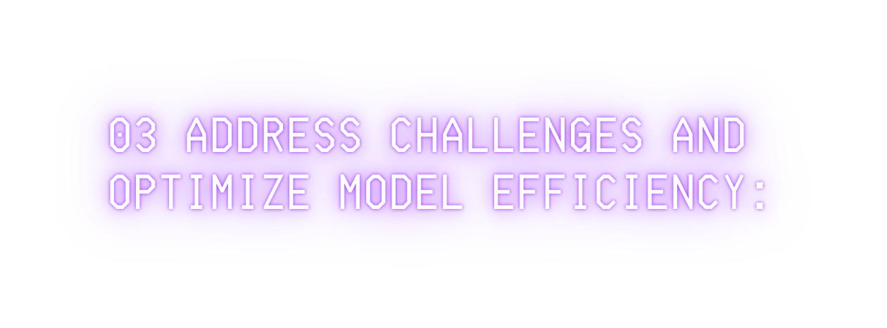


Implement data pre-processing techniques to clean and prepare the text corpus for model training.
Build a deep learning model, such as an LSTM or transformer architecture, capable of accurately predicting the next word in a sequence.
Ensure the model is trained on a diverse dataset to capture a wide range of language patterns and contexts.
Deploy the next-word prediction
Investigate techniques to mitigate challenges such as data scarcity, computational complexity, and model size.
Explore methods such as transfer learning, pruning, and compression to improve model efficiency and scalability.
Strive to achieve a balance between prediction accuracy and computational resources required for real-time operation, particularly on resource-limited devices like smartphones.
model in real-world applications such as text completion, auto-
correction, and chatbots to assist users in typing or speaking more efficiently.
Evaluate the model's performance in terms of prediction accuracy and speed to ensure a seamless user experience.
Continuously refine and update the model based on user feedback and usage patterns to improve its effectiveness over time.

Slide 5




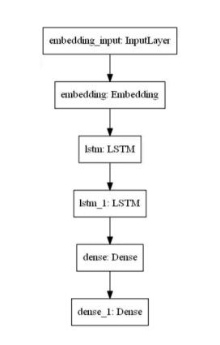


The proposed architecture involves:
Pre-processing the Dataset: Irrelevant data from the Metamorphosis dataset is removed, and the cleaned dataset is saved as Metamorphosis_clean.txt. Additional cleaning is done to remove extraneous elements, enhancing the quality of the training data.
Model Creation: A sequential model is built, starting with an embedding layer. LSTM layers are added for sequence processing, followed by a hidden layer with relu activation. An output layer with SoftMax activation generates probabilities for each output word.
Tokenization: Text tokenization using the Keras Tokenizer converts texts to sequences of integers. Training datasets are created, and output data is converted to categorical data for compatibility with the loss function.
These steps streamline text data preparation and model construction for effective next-word prediction.

Slide 6
METHODOLOGY
NEXT WORD PREDICTION, A COMMON TASK IN NATURAL LANGUAGE PROCESSING (NLP), IS APPROACHED THROUGH VARIOUS DEEP LEARNING TECHNIQUES. HERE'S A SIMPLIFIED PROCESS:
DATA PREPARATION:
Collect a large corpus of text data and preprocess it by removing stop words, lower-casing the text, and tokenizing it into individual words.
CREATE THE TRAINING DATASET:
Construct the training dataset by using sequences of words from the corpus, where the next word in the sequence becomes the label.
Techniques like sliding windows or overlapping
sequences can be used to create multiple training examples.
04 MODEL EVALUATION:
Assess the model's performance using metrics such as perplexity or accuracy on a separate test dataset.
05 DEPLOYMENT :
Deploy the trained model for next word prediction. Given a sequence of words, the model predicts the most probable next word.
03 MODEL BUILDING:
Utilize a recurrent neural network (RNN) like LSTM or GRU to develop a language model for next word prediction. The model takes a sequence of words as input and predicts the next word. Training techniques like backpropagation and stochastic gradient descent are employed.

Slide 7


TECHNOLOGIES AND LIBRARIES
1
TensorFlow and Keras:
Core libraries for machine learning and neural networks.
4
LSTM (Long Short-Term Memory): Captures sequential dependencies in text data.
Callbacks: Perform actions during training (e.g., saving best model, adjusting learning rates).
7
2
Tokenizer: Converts text into sequences of integers for model input.
Dense Layer: Maps LSTM outputs to vocabulary size for prediction.
5
8
Numpy: Handles numerical data efficiently.
3
Embedding Layer: Creates word embeddings.
6
Optimizer (Adam): Adjusts learning rates during training.
pickle: Serializes/deserializes
9
Python objects (used to save/load tokenizer object).

Slide 8
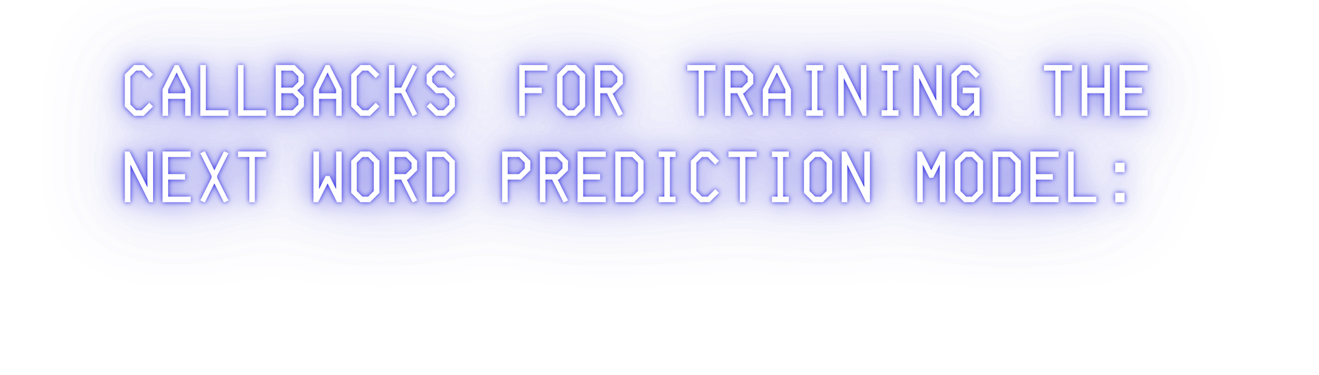


ModelCheckpoint:
This callback is used for storing the weights of our model after training. We save only the best weights of our model by specifying save_best_only=True. We will monitor our training by using the loss metric.
ReduceLROnPlateau:
This callback is used for reducing the learning rate of the optimizer after a specified number of epochs. Here, we have specified patience as 3. If the accuracy does not improve after 3 epochs, then our learning rate is reduced accordingly by a factor of 0.2. The metric used for monitoring here is loss as well.
Tensorboard
The tensorboard callback is used for plotting the visualization of the graphs, namely the graph plots for accuracy and the loss. Here, we will only be looking at the loss graph of the next word prediction

Slide 9
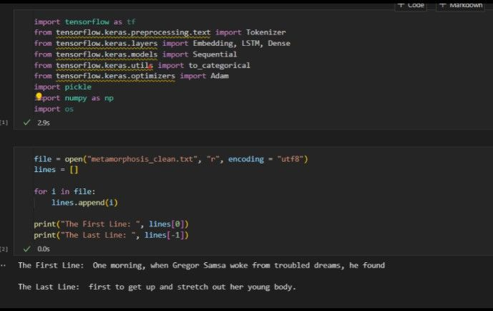
IMPLEMENTATION

Slide 10
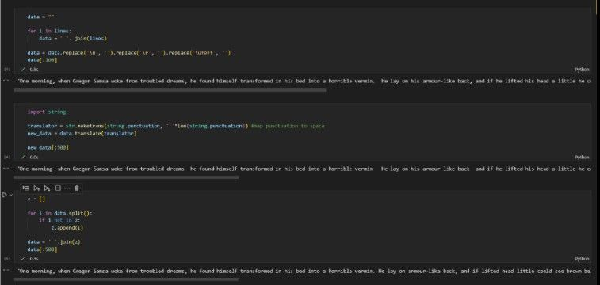

Slide 11
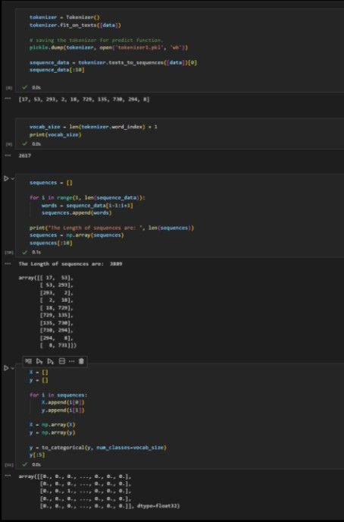
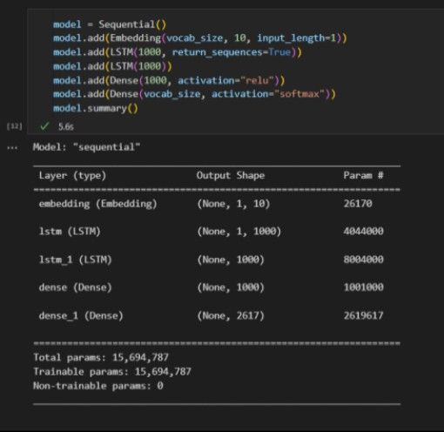

Slide 12
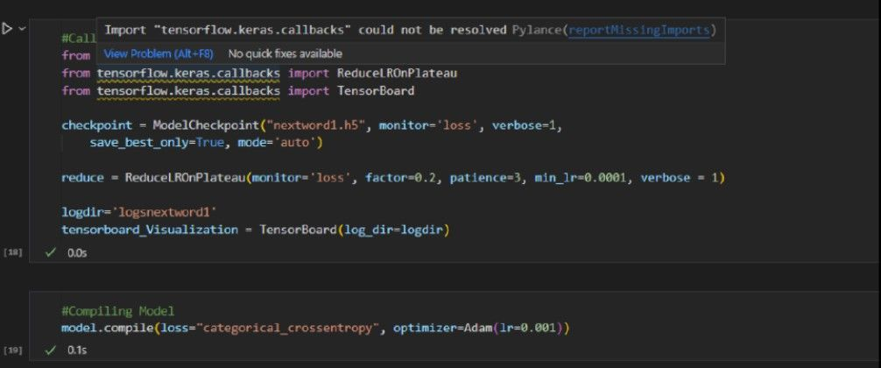
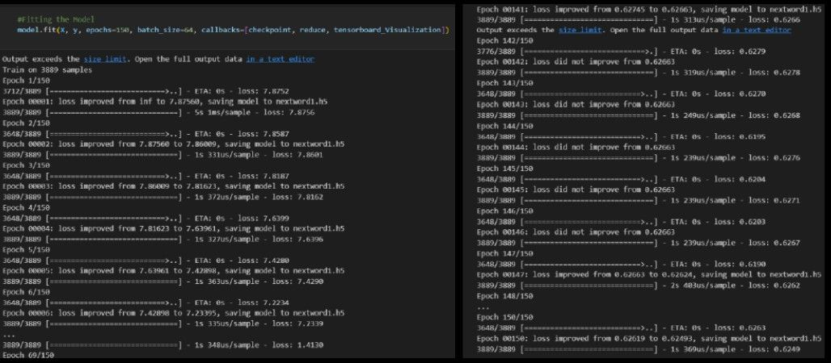

Slide 13
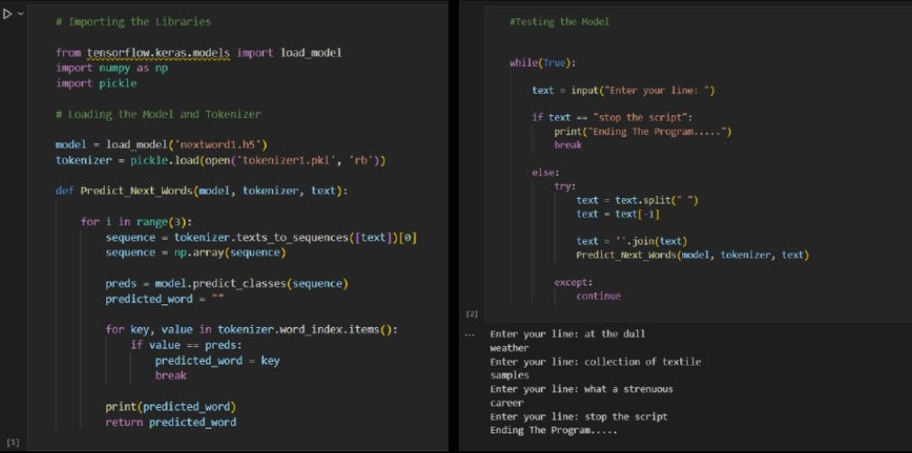
R e s u l t

Slide 14

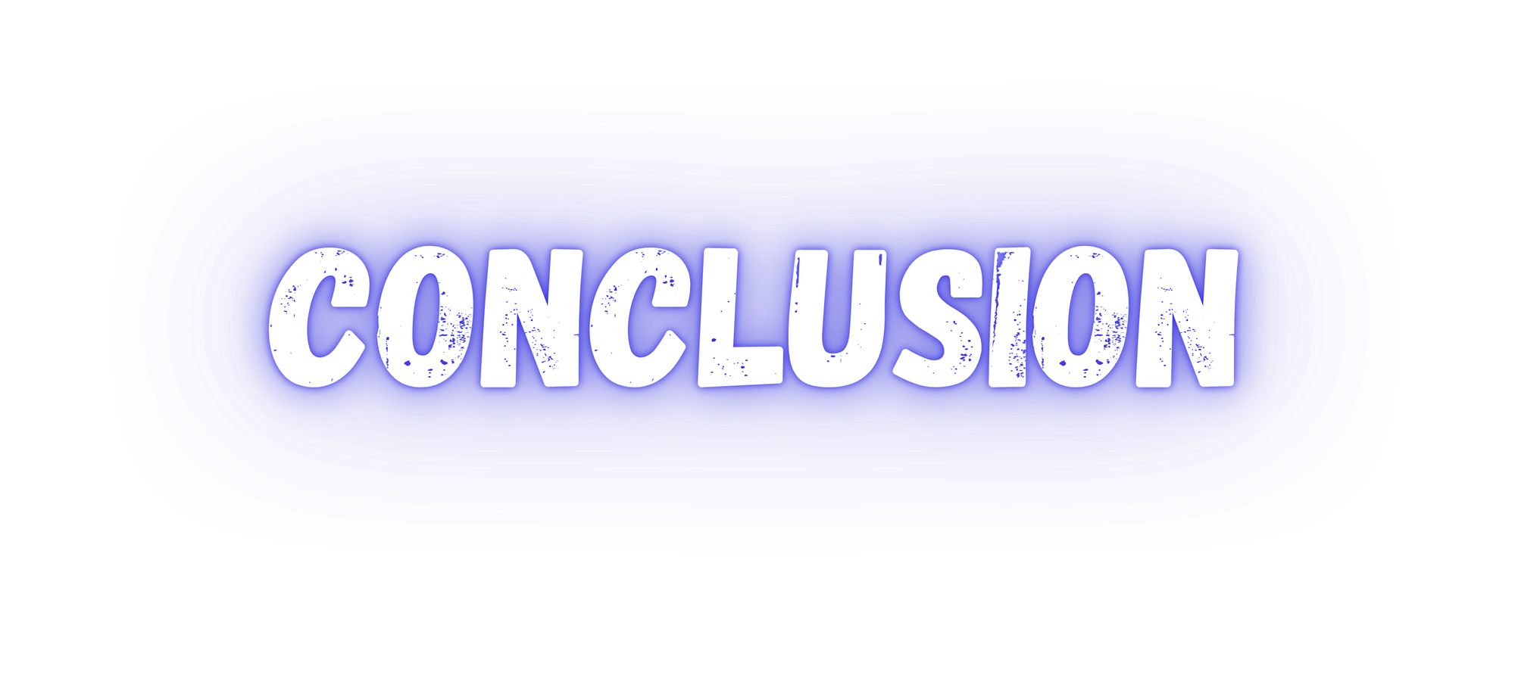




In conclusion, next-word prediction, driven by NLP and deep learning, is now pivotal in applications such as text completion, auto-correction, and chatbots. While deep learning advancements have boosted accuracy by capturing intricate word relationships, challenges like data acquisition and computational efficiency persist. Proposed solutions like transfer learning and model pruning aim to mitigate these challenges, while future enhancements may involve integrating domain-specific knowledge and prioritizing explainability. Overall, ongoing advancements promise continued progress in accuracy and efficiency, shaping the future of natural language processing.

Slide 15

